Slide 1


Social Stories™
Carol Gray initiated and defined the term Social Story in 1991.
Social Stories are an evidence-based strategy.
There is only one definition of a Social Story.
©Carol Gray, 2017. All rights reserved. Definition and sample Social Stories retrieved with permission as a member of Carol’s Club, www.CarolGraySocialStories.com. Restricted permission granted for use in its entirety as part of a Member presentation.
Notes:
Speaker Notes:
Carol Gray initiated the use of the term Social Story in 1991 to describe accurate and unassuming descriptions of people, places, activities, skills, and concepts. Shortly thereafter, the first definition of the term Social Story was published in a formal journal in an article that she co-authored with Joy Garand (Nichols) titled, “Social Stories: Improving Responses of Individuals with Autism with Accurate Social Information.”
Gray, C. A., & Garand, J. (1993). Social Stories: Improving responses of individuals with autism with accurate social information. Focus on Autistic Behavior, 8, 1-10.
In 2010, The National Autism Center listed “story-based intervention package” (with Social Stories™ identified as the most well-known) as one of eleven established treatments for children on the autism spectrum. National Autism Center. (2010). National Standards Project. Retrieved from www.nationalautismcenter.org.
People often use the term ‘Social Story’ in reference to anything in writing, often without realizing that it is a clearly defined and researched literary format. Reserving ‘Social Story’ for stories that meet the 10 criteria, sometimes referred to as the defining characteristics, is important to clear communication between caregivers and professionals, research efforts, and the future quality, integrity, and safety of the approach.

Slide 2
Social Stories™ 10.2
Definition
A Social Story accurately describes a context, skill, achievement, or concept according to 10 defining criteria.
Notes:
Speaker Notes:
Social Stories have changed very little over time. The definition of a Social Story is periodically updated, revised, and reorganized to reflect current research and cumulative experience with the approach.
The Social Story definition is very important because:
It helps us determine what is, and what is not, a Social Story.
It makes it possible to conduct Social Story research, so that we are comparing ‘apples to apples’.
It represents the most important elements of Social Stories that work to increase the likelihood that the Story will have a positive and effective impact, and that it will be safe for the audience
(Read the entire definition which appears on this slide and the next five slides.)

Slide 3

These criteria guide Story
research, development,
and implementation…

Slide 4

…to ensure an overall
patient and
supportive quality…

Slide 5

…and a format, “voice”, content,
and learning experience
that is…

Slide 6

…descriptive, meaningful, respectful, and physically, socially, and emotionally safe…

Slide 7

for the Story audience (a child, adolescent, or adult).

Slide 8
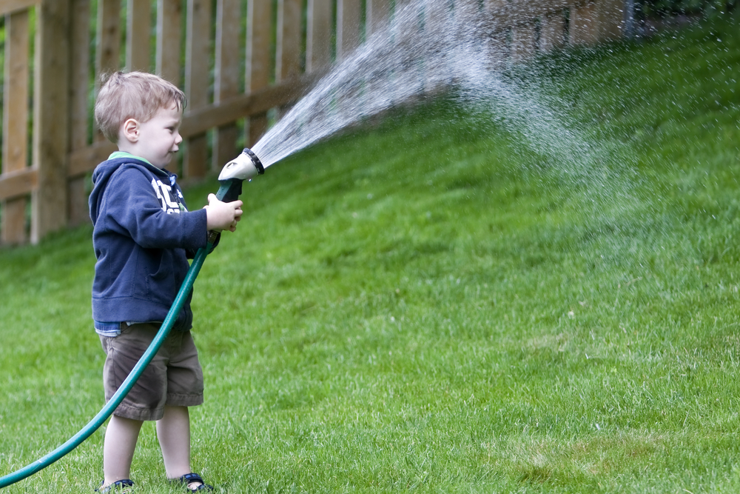
I Watered the Grass!
Dad asked me to help him water the grass and flowers.
I had never watered grass before. I learned how to use the sprayer.
This is a photo of me watering the grass. Dad felt happy that I helped him.
Notes:
Speaker Notes
There are ten detailed criteria that distinguish Social Stories from social scripts or other visual strategies. For example, the second criteria requires that at least half of all Social Stories developed on behalf of an individual praise what that person does well, as in this Story titled, “I Watered the Grass!”

Slide 9


My Washing Machine Story
Notes:
Speaker Notes
One of the earliest Stories was developed for a 2 year old toddler. He would scream non-stop if the washing machine in his home was turned off.
A very short Story described when and why a washing machine is turned off, without mentioning the child’s screaming or suggesting that the child stay calm when the washing machine is turned off.
The Story was immediately effective, with mom making sure to keep the lid up when the machine was turned off, and displaying the on or off photos from the Story on the washing machine to match its current status.

Slide 10
My Washing Machine Story
Sometimes we wash clothes.
Mom knows when to wash clothes.
The washing machine is on when we wash clothes.
Notes:
Speaker Notes
This is the Story. Note that it does not mention the toddler’s distress, instead focusing on information that he may not have or understand.
The Story was immediately effective.

Slide 11
My Washing Machine Story
Sometimes we do not need to wash clothes. The washing machine is off. This is okay.
Sometimes we wash clothes.
Notes:
*
NOTES / CONTENT
In Social Stories 10.2, I wanted to provide as many examples of Social Stories as possible, and to begin providing those examples early in the workshop.
At the same time, I want to be time efficient in the process.
I encourage you to use a short, simple Social Story example from your own work
Describe how the topic was identified, Story developed, and the outcome

Slide 12

Social Articles
Notes:
Speaker Notes
Social Stories are developed for people of all ages.
Social Articles adhere to the same ten Social Story criteria, using vocabulary and content for older or more advanced Audiences.

Slide 13
www.CarolGraySocialStories.com
Current information / Free Articles /
Workshops / Carol’s Club
Notes:
This is the Social Story logo. It identifies genuine Social Story resources and materials.
I invite you to visit the official online home of Social Stories for the most current information, a wealth of free articles, as well as information about workshops and the very new Carol’s Club.

