Slide 1
A Social Story for the Rest of Us

Slide 2
I am a typical adult. I have a son, daughter, student, or client who is diagnosed with autism. “Autism, or autism spectrum disorder (ASD), refers to a broad range of conditions characterized by challenges with social skills, repetitive behaviors, speech and nonverbal communication” (Autism Speaks).

Slide 3
Dr. Stephen Shore, a professor at Adelphi University and person with autism has said that, “If you’ve met one person with autism, you’ve met one person with autism” (Shore, as cited on the Autism Speaks website). This means that I may find myself needing to learn about autism over and over again and as long as I keep meeting people with autism. This is okay.

Slide 4
Every person is the result of a combination of genes and life experiences. Together they express themselves in a one-time-only physical appearance and a never-to-be-repeated constellation of strengths, weaknesses, temperament, personality, and talent.

Slide 5
Despite that, typical people often perceive and respond to sights, sounds, and social factors within a similar “or typical” range. As they grow, they begin making assumptions about what other people know, think, feel, or believe and pride themselves in how often they are right. I will try to abandon thinking I am right about this sort of thing all the time.

Slide 6
Just like everyone else, a child, adolescent, or adult with autism is unique. In a way, having autism is like being unique twice - once as a person and again because of autism. With autism, the perception and
interpretation of sights, sounds, and social factors
are atypical at times. When I’m with a person with
autism, I will try to recognize all that we have in
common, respect the differences, and respond
accordingly.

Slide 7
Adults often attribute typical intent or motivation to explain the atypical responses of a child with autism. They are likely to be in error. Autism is more at ease with those who are socially curious, who take time to gather information about how things look, sound, and feel to another person.

Slide 8
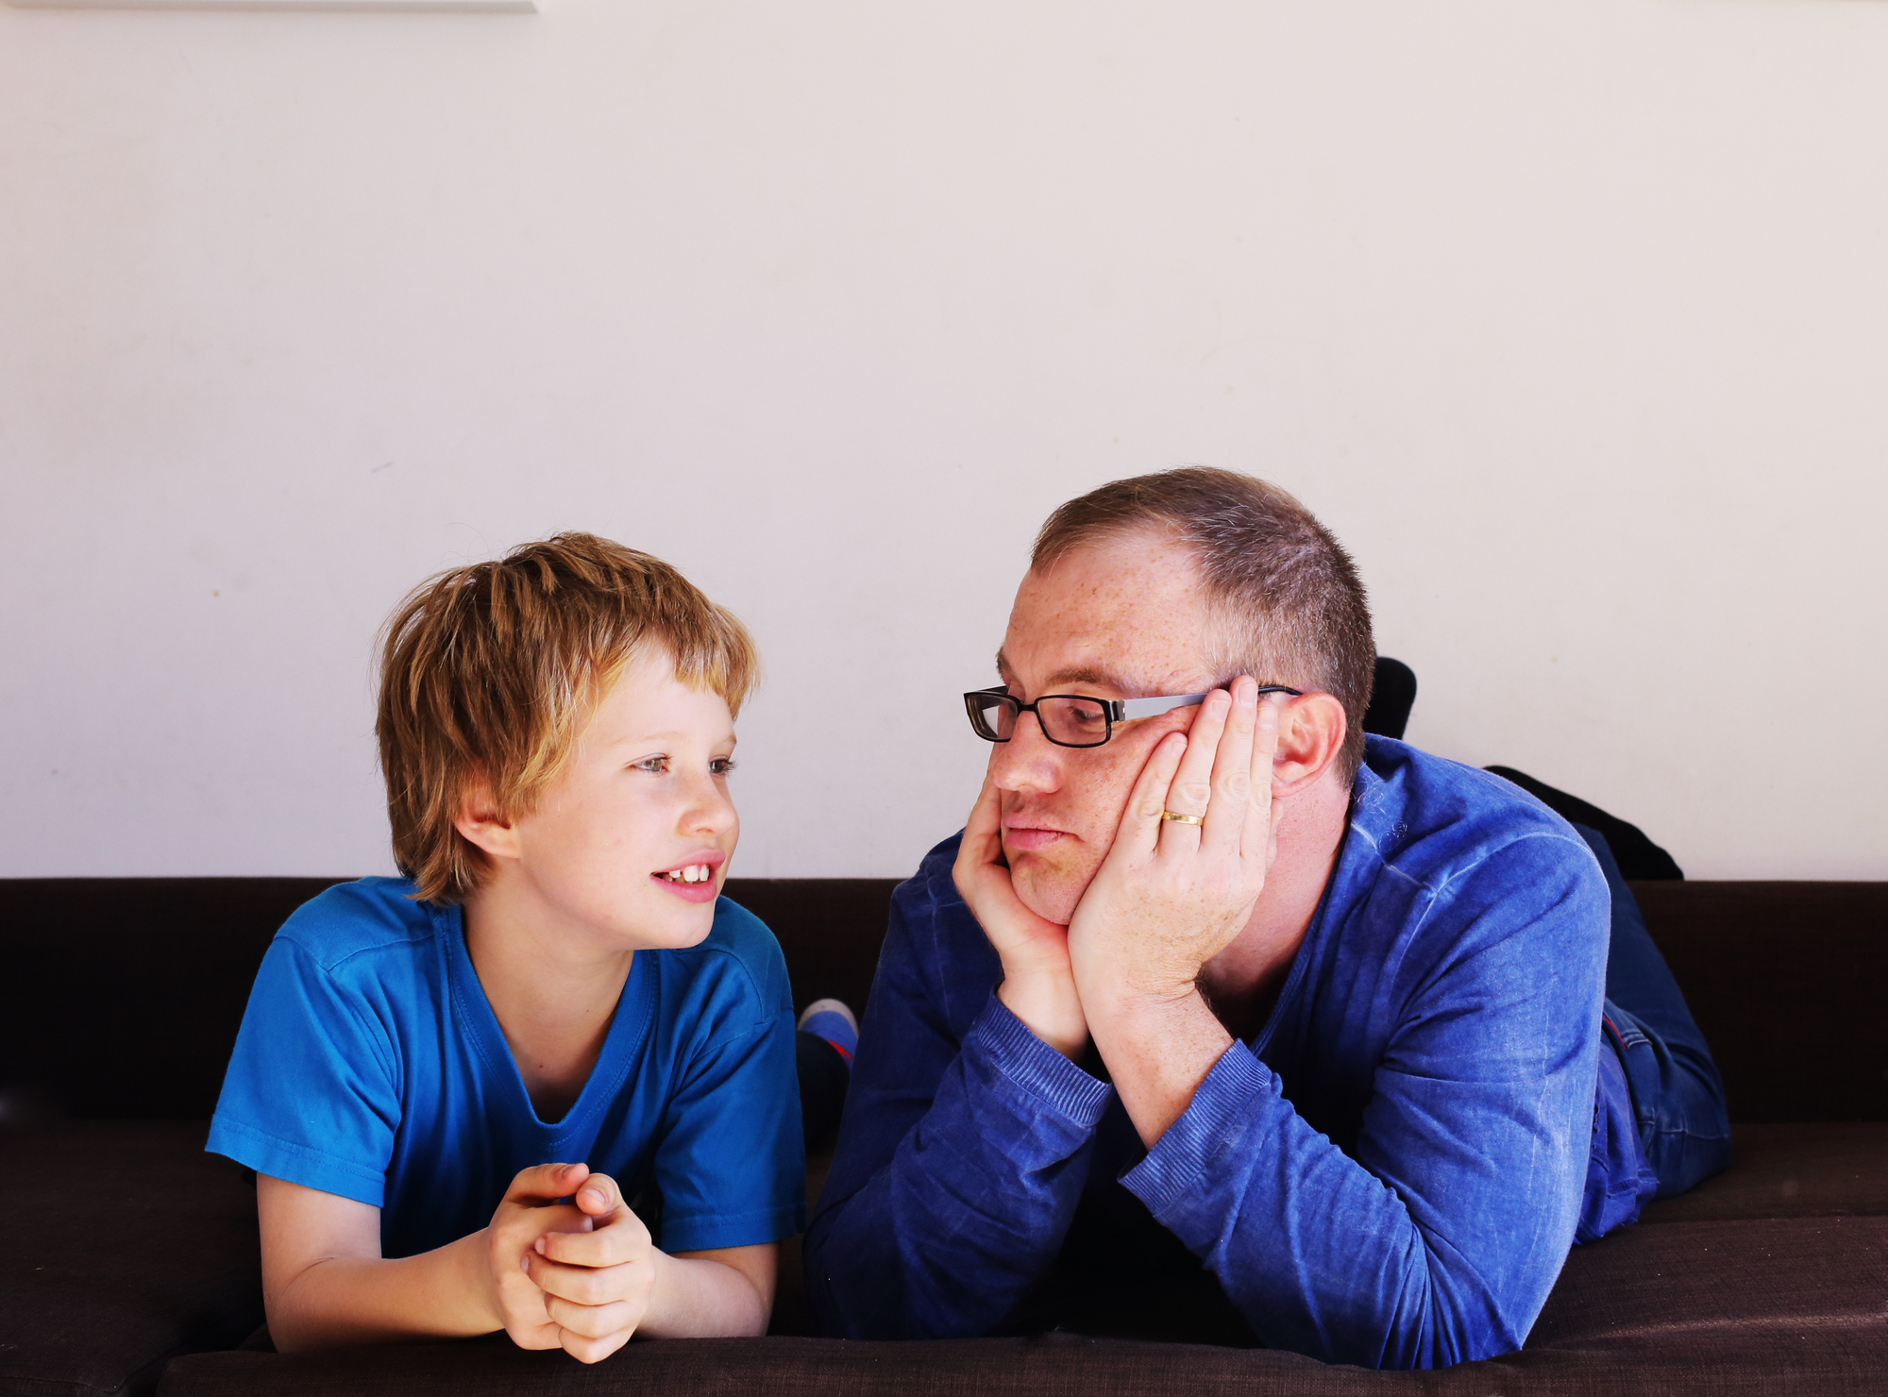
Social curiosity comes naturally to some people; others learn it with practice. A few people are “socially decided” and do not entertain the possibility of human experiences outside of their own. I will try to be socially curious.

Slide 9
A sense of humor is essential when working with a child, adolescent, or adult with autism. Humor renews energy and resets focus, and sustains the Socially Curious when they are confused.

Slide 10
It is theorized that curious people make fewer social errors and are more likely to recognize and fix the mistakes that they do make. I will try to process my mistakes with creativity and a forgiving sense of humor.

Slide 11
To successfully raise, teach, or consult on behalf of an individual with autism is to ensure equal access to information. People with autism may be misled by anything animate or inanimate; from nonverbal social factors to a single word in conversation or a billboard along the highway.

Slide 12
Whether I am a parent or teacher, therapist or physician, I am part of an educational team. The best educational teams recognize that:

Slide 13
Atypical responses may be rooted in atypical perception.
Feeling safe facilitates learning.
Passion and interests often
hold attention.

Slide 14
Being social is often fun and best taught that way.
People are usually employed doing something that they have done well all along.
What adults say and do, and how they say and do it, matters. A lot.
I will try to be an effective member of an educational team.

Slide 15
Supportive adults: 1) systematically provide personally responsive structure to complete coursework, 2) meaningfully describe social concepts and factors (including those that “everybody knows”), and 3) whenever possible anticipate when information is needed and provide it in advance. I will try to ensure that those in my care have accurate and reliable information - whether in retrospect or in advance - that they need to complete each day comfortably.

Slide 16
I am learning about autism and am ready to learn about it repeatedly. Each person is unique. Autism is never the same twice, either. Social curiosity complements autism. Humor re-energizes patience and re-sets attention and focus. Children, adolescents, and adults with autism sometimes need educators to structure and ensure their equal access to information. Everything that I say and do on behalf of a person with autism matters. Positive and creative teaching fosters growth.

Slide 17
My name is ______________. I will try to keep this Story in a safe place just in case I need to read it again sometime.

