Slide 1
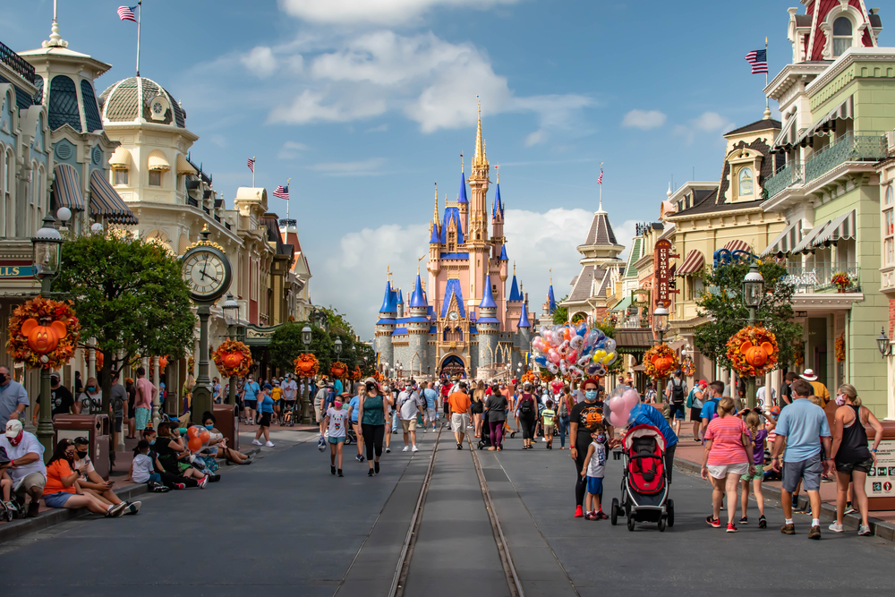
My Family is Planning to Go to Disney World

Slide 2
Disney World is a very big amusement park. This is Main Street in Disney World. At Disney World, there are times when it is safe and okay for families to walk together on Main Street.

Slide 3
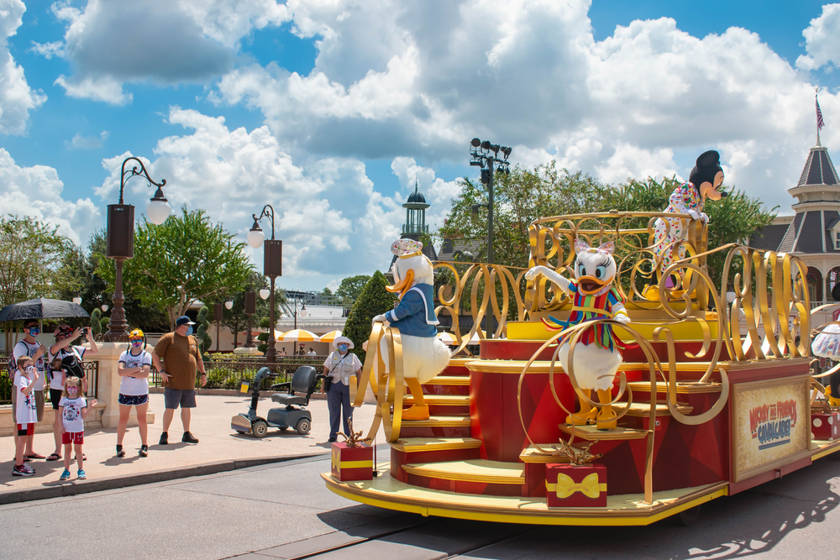
If there is a parade, people are directed to stand at the side of the street. This helps to keep everyone safe. There may be other times when people need to stay out of the street, too.

Slide 4
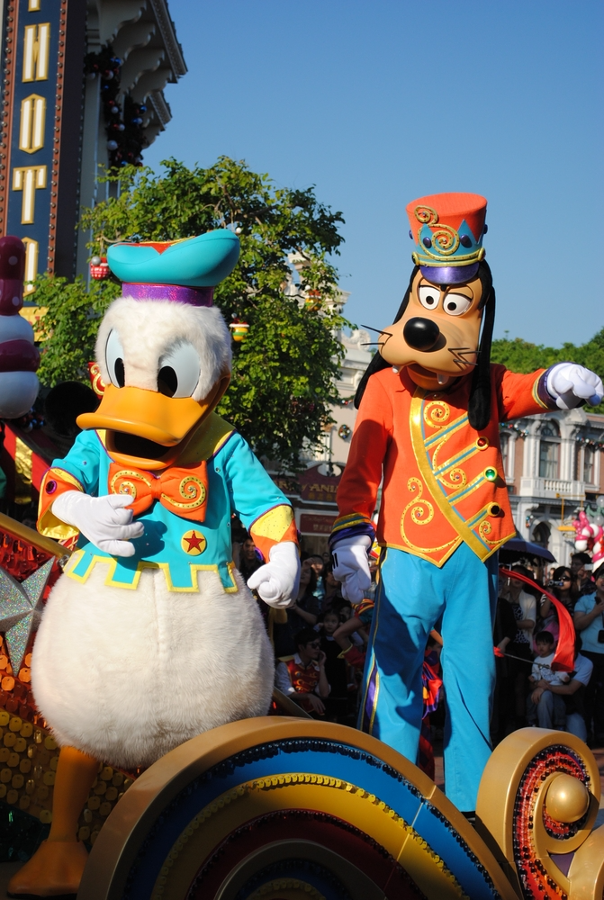
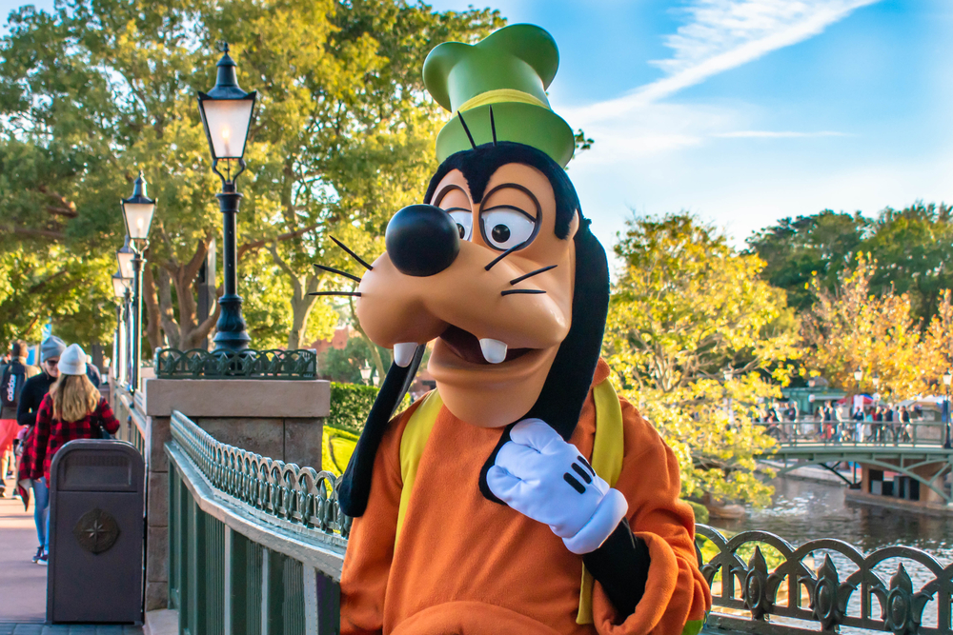
There are many things for people to see at Disney World. We may see big, tall characters like Donald Duck and Goofy.

Slide 5
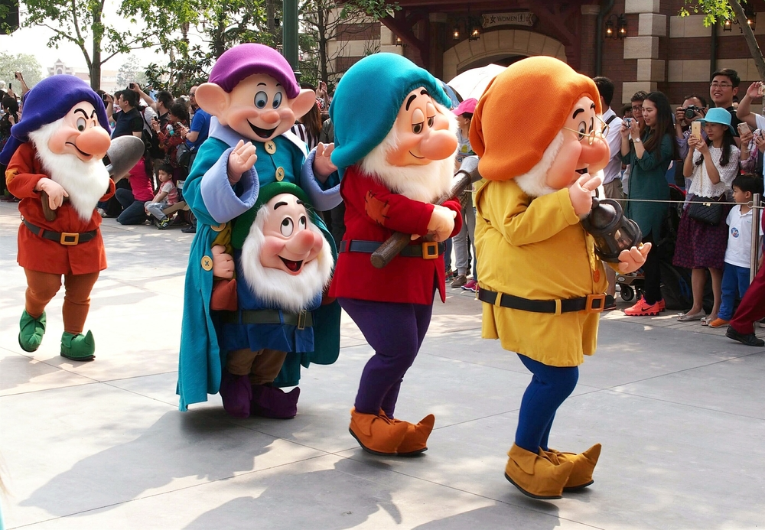
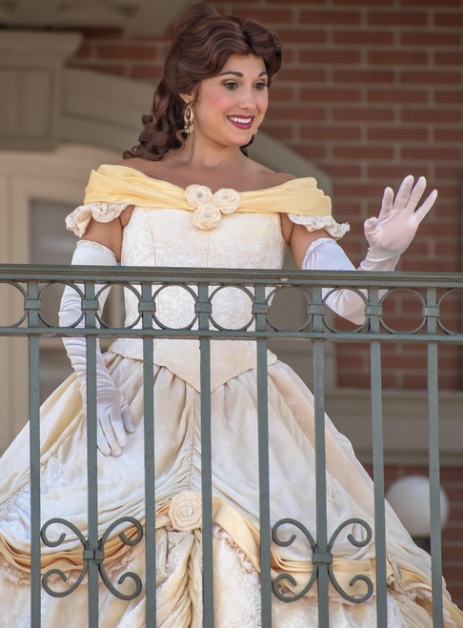
We may see other kinds of characters, like the Seven Dwarfs or one of the princesses, like Belle.

Slide 6
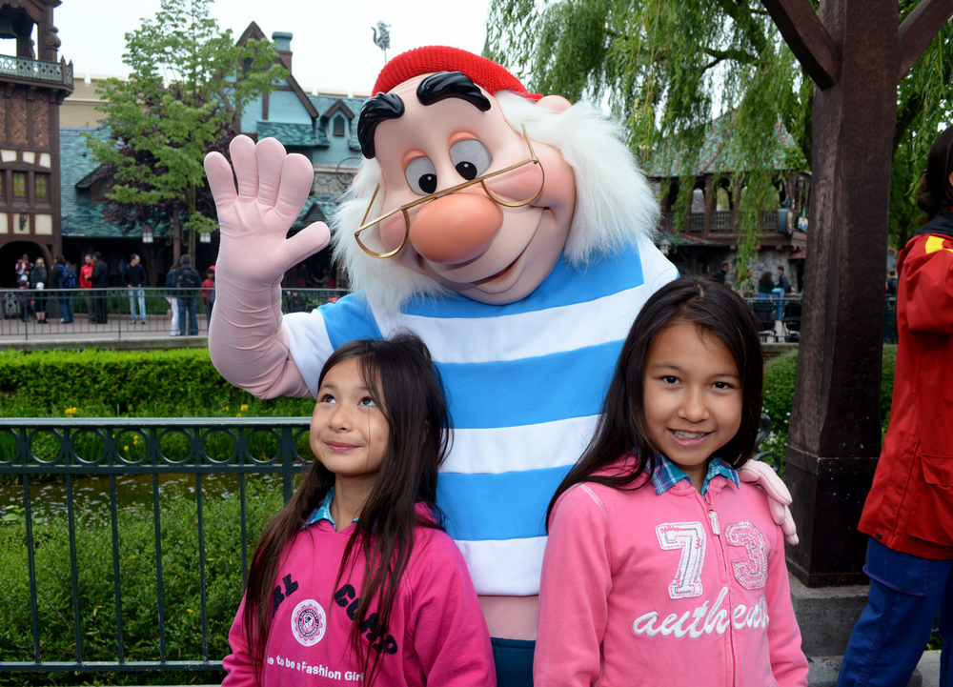
Sometimes characters pose with children while someone takes their photo together.

Slide 7
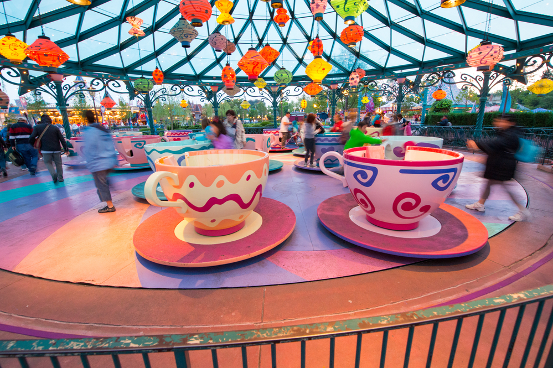
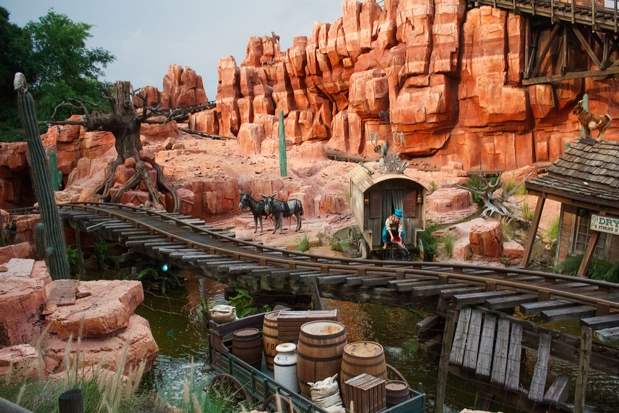
There are many things to do at Disney World. There are rides for children. There are other rides for people who are bigger or older.

Slide 8
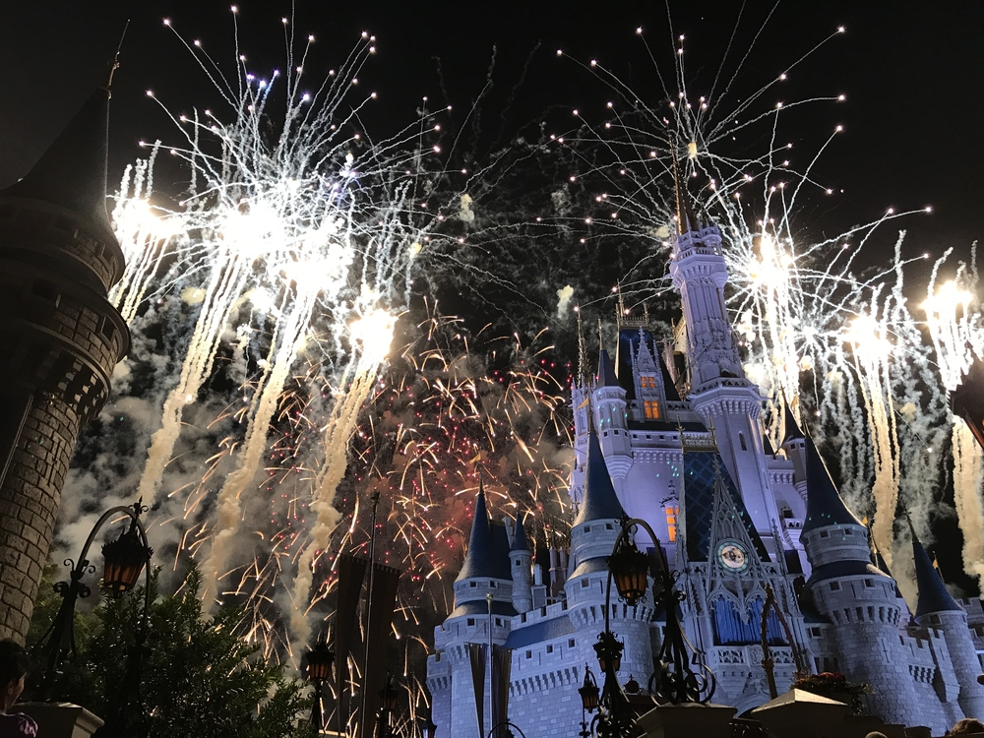
We may stay until it is dark enough to see the fireworks. Or we may leave before the fireworks.

Slide 9
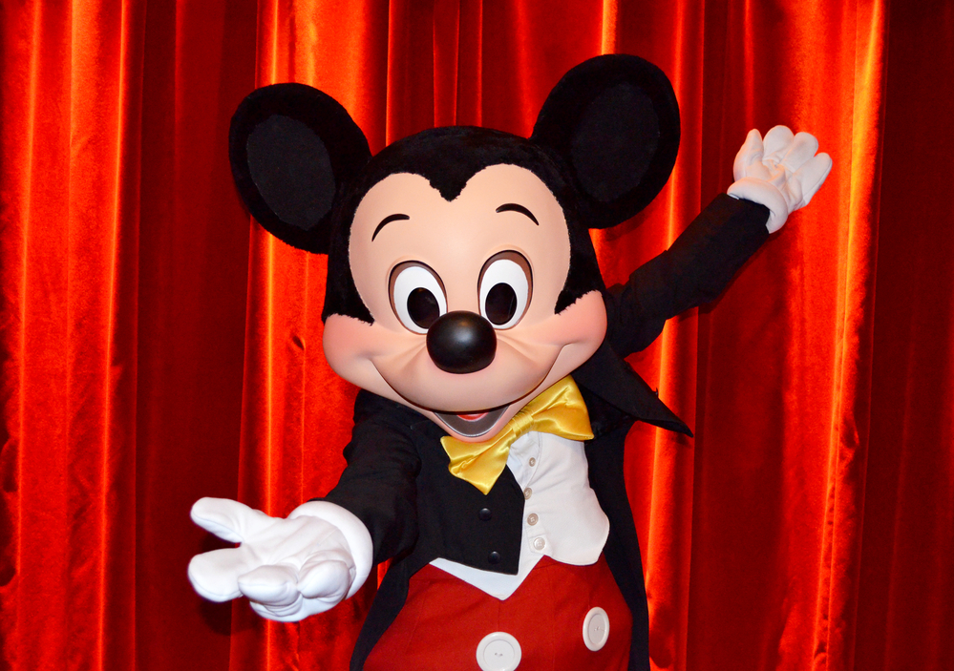
My family is planning to go to Disney World. There are many things to see and do there.

